Slide 1

Traffic Simulation
Project Core Phase-Procp
Group 3 – Mikaeil, Mervin, Tarwiya, Seun

Slide 2
Group Members
Client
(Mr.George)
Tutor
(Ms.Maja)
Project Leader
(Mikaeil Shaghelani)
Programming manager
Mervin Vrolijk
Design manager
Mikaeil Shaghelani
Testing manager
Tarwiya
Quality manager
Seun

Slide 3
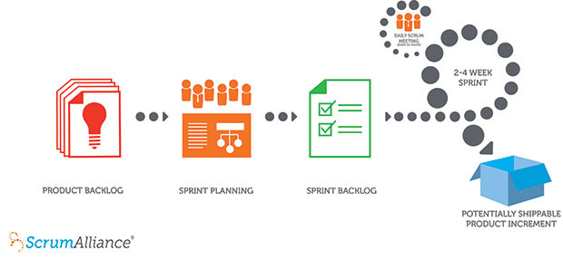
Step One Analyze
Gathering Requirements
Domain Analysis
Behavioral Modeling
Structural Modeling
Dynamic Modeling
Scrum
Notes:
Scrum is an Agile framework for completing complex projects

Slide 4
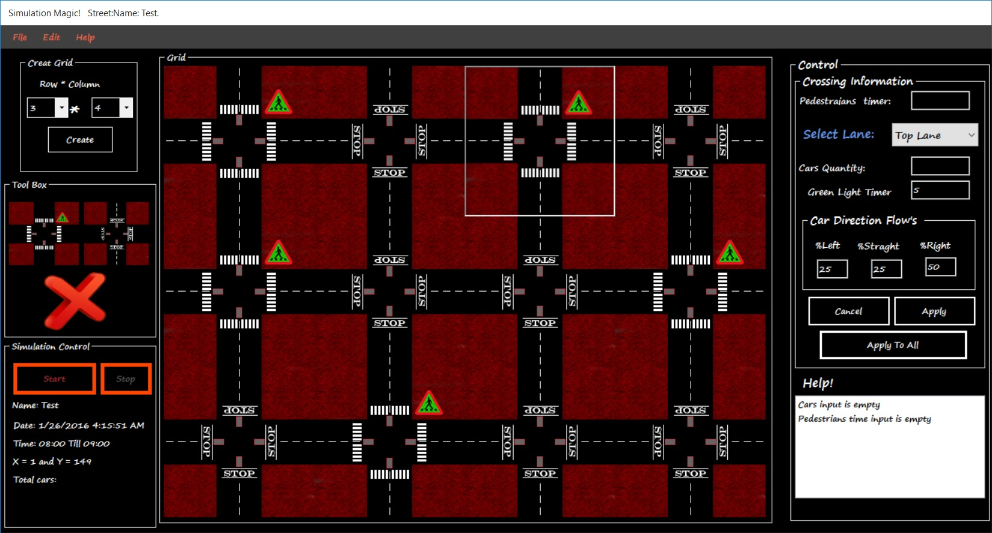
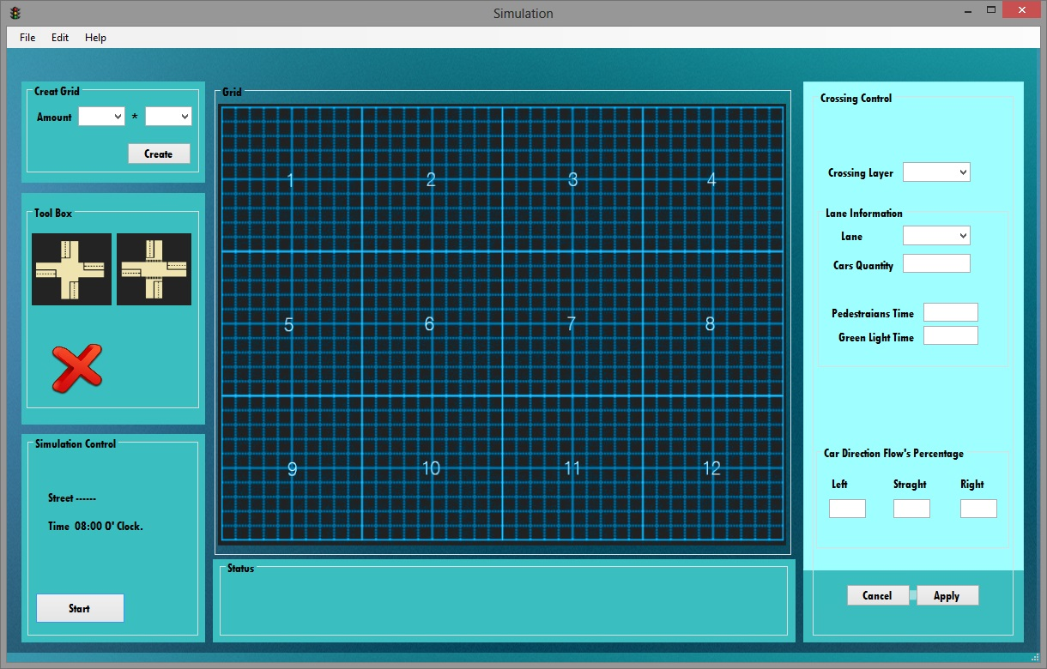
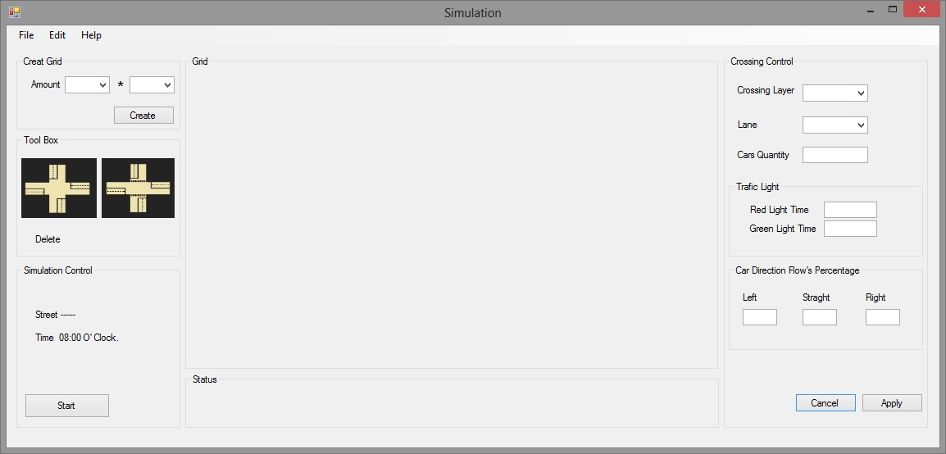
Step Two Design
User research, job shadowing, contextual interviews, personas.
Activity centered design, and text usability.
Hierarchies, card sorting, mental model.
Sketching, paper prototyping, guerilla testing.
Realism, NUI’s, Fit’s law, animations, consistency, discoverability, interrupt, undo, modes, opinions and hierarchies.
(Guerilla) usability testing, remote testing, mistakes, user error.
Building the final prototype.

Slide 5
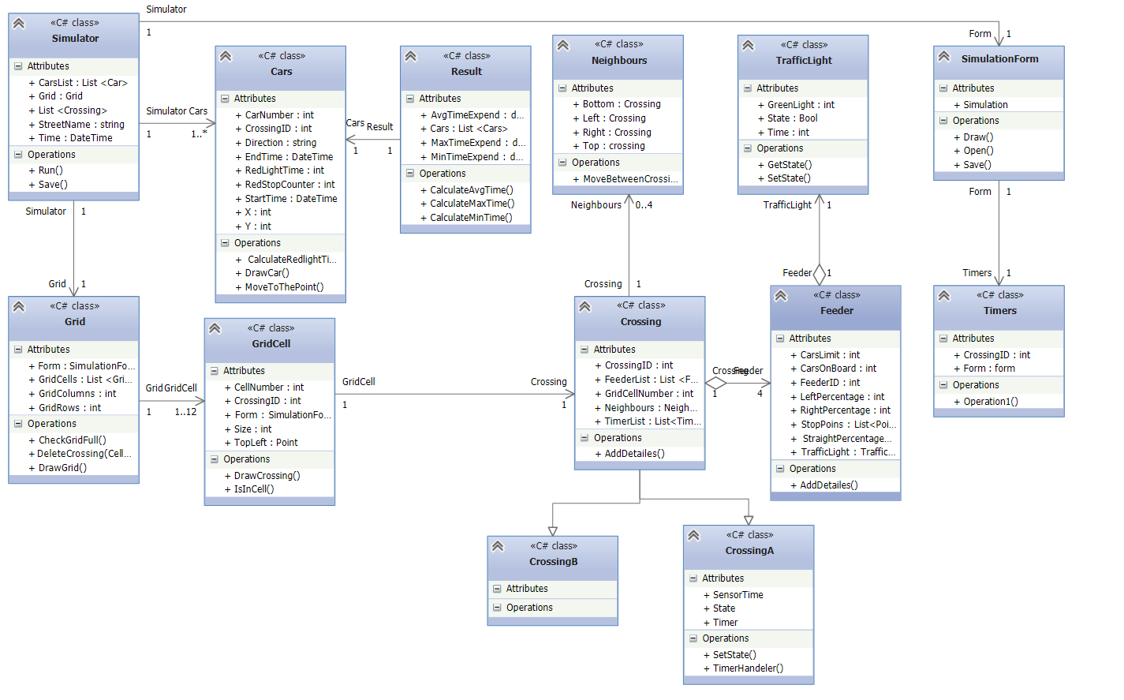
Step Three Developing
Strategy Pattern
Observer Pattern
Memento Pattern
Command Pattern
Abstract Factory Pattern
Decorator Pattern
….
Notes:
-classes relation and composition
Simulator class observes everything
-memento and command are about operation over shared data
-create objects
Attach more information around an object

Slide 6
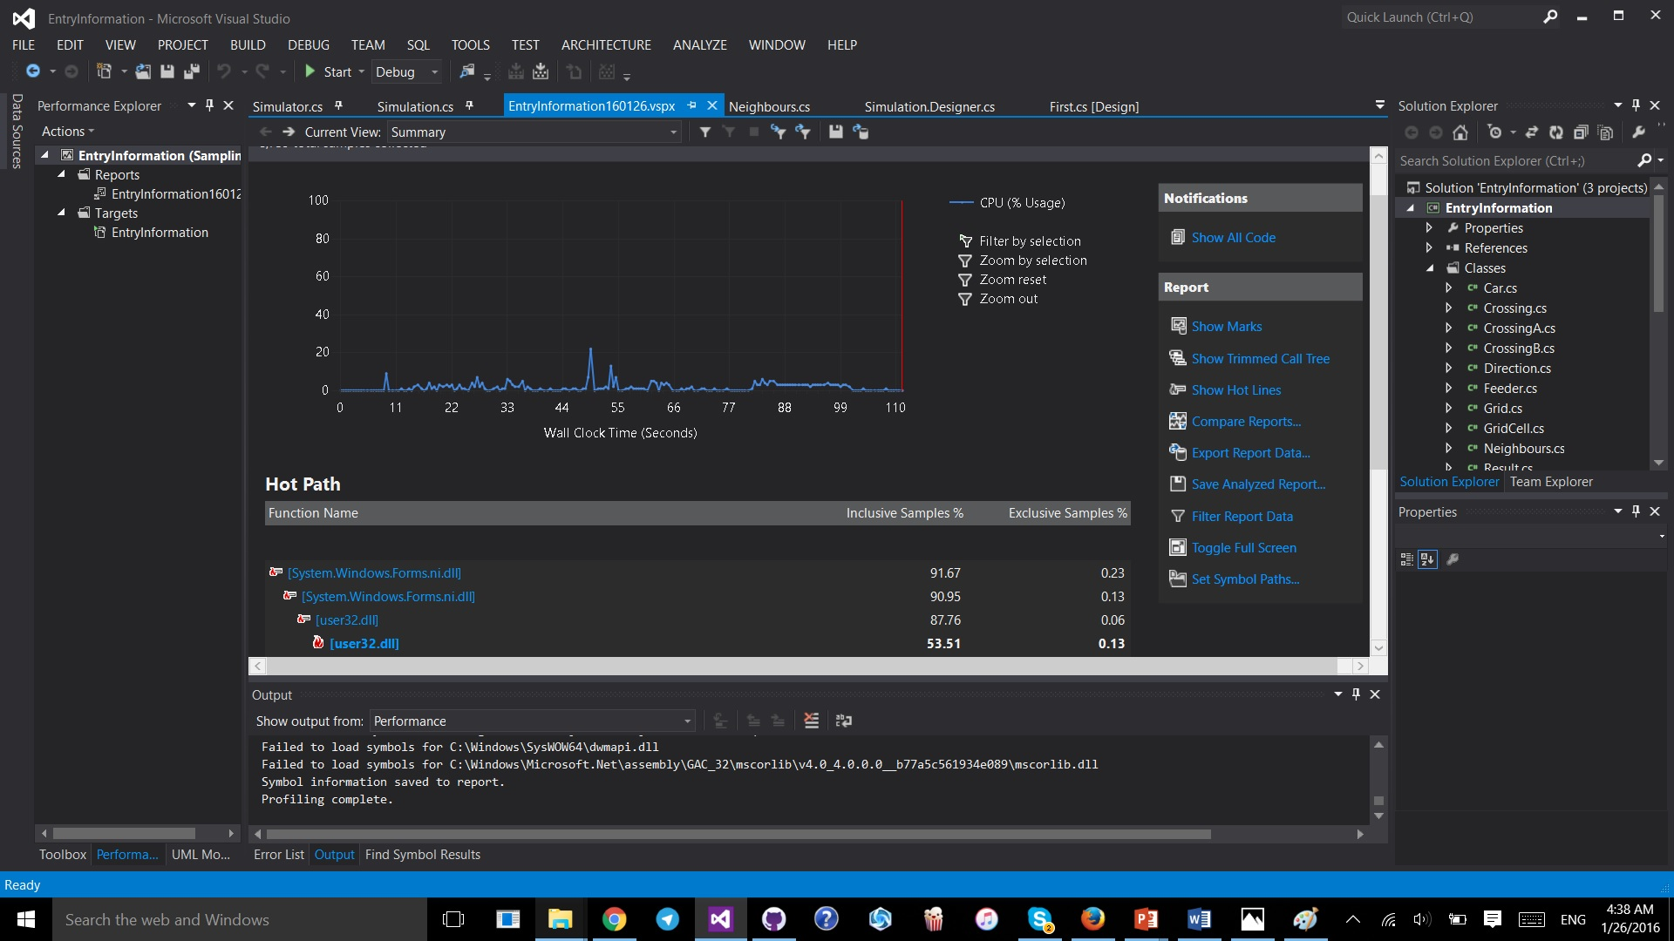
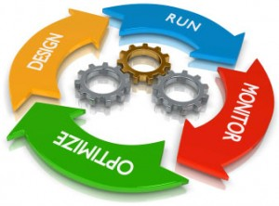
Step Four Testing
Test Plan
Developing subsystem’s test
Component Testing

Slide 7

Question Time
Demo Time

